Slide 1
VAE Claim
Make sufficiently complex latent distribution
Possible Solution:
1. Strengthens the encoder
Is something more possible than using full covariance?
2. Enhance sampling (like LDM)
Assuming the decoder is just fine!!!

Slide 2

Sampling of VAE
Generation of VAE relies on $p(z)$ to produce an ideal latent dist.
An ideal latent distribution : $\sum_{x}{q_{φ}(z|x)}$ or ${p\left(x\right)=∫p}_{θ}\left(x | z\right)p(z)$ ?
But vanilla VAE only uses $D_{KL}(q_{φ}(z|x_{i})||p\left(z\right))$

Slide 3
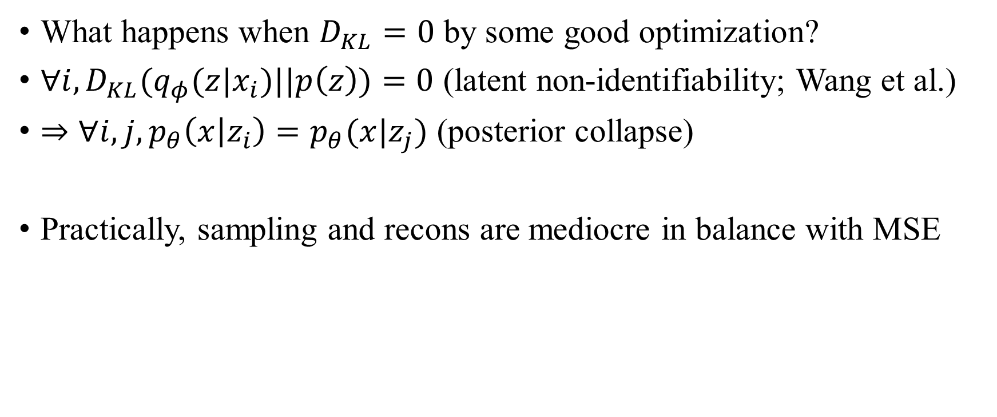
Posterior Collapse
What happens when $D_{KL}=0$ by some good optimization?
$∀i, D_{KL}(q_{φ}(z|x_{i})||p\left(z\right))=0$ (latent non-identifiability; Wang et al.)
$⇒∀i, j, p_{θ}\left(x | z_{i}\right)=p_{θ}(x|z_{j})$ (posterior collapse)
Practically, sampling and recons are mediocre in balance with MSE

Slide 4
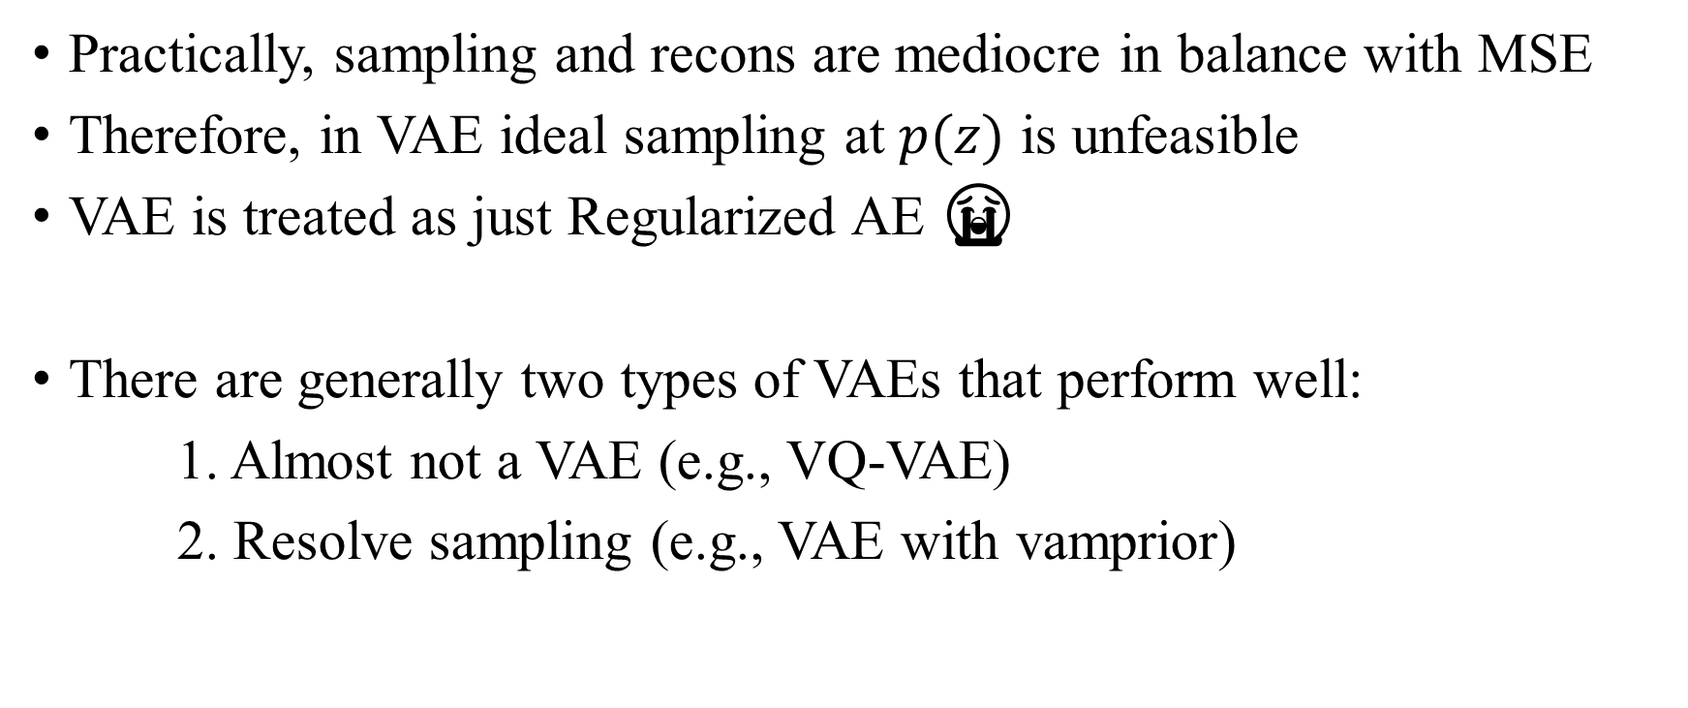
Practical VAE
Practically, sampling and recons are mediocre in balance with MSE
Therefore, in VAE ideal sampling at $p(z)$ is unfeasible
VAE is treated as just Regularized AE 😭
There are generally two types of VAEs that perform well:
1. Almost not a VAE (e.g., VQ-VAE)
2. Resolve sampling (e.g., VAE with vamprior)

Slide 5
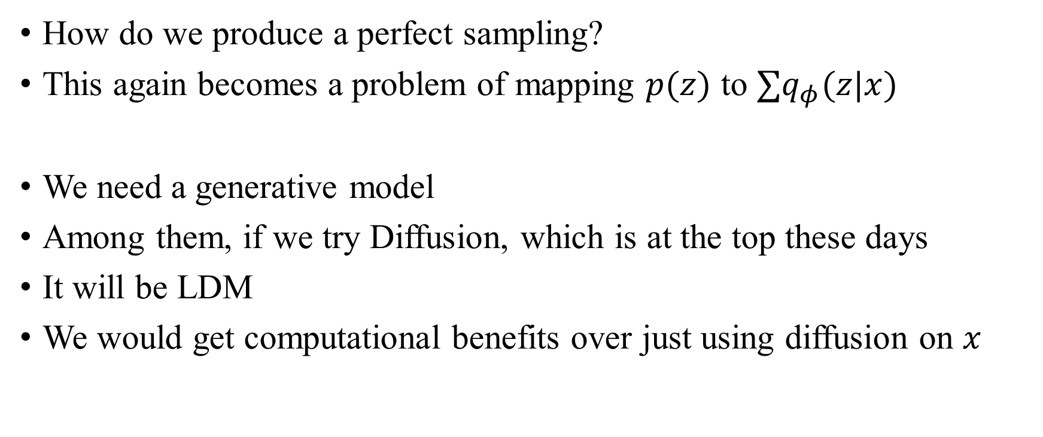
Why LDM works well
How do we produce a perfect sampling?
This again becomes a problem of mapping $p(z)$ to $∑q_{φ}(z|x)$
We need a generative model
Among them, if we try Diffusion, which is at the top these days
It will be LDM
We would get computational benefits over just using diffusion on $x$

Slide 6
Possibility of regularized AE
However, the performance of LDM depends on the distribution created by the outer regularized AE
This means that AE alone can achieve excellent performance if we sample well

Slide 7
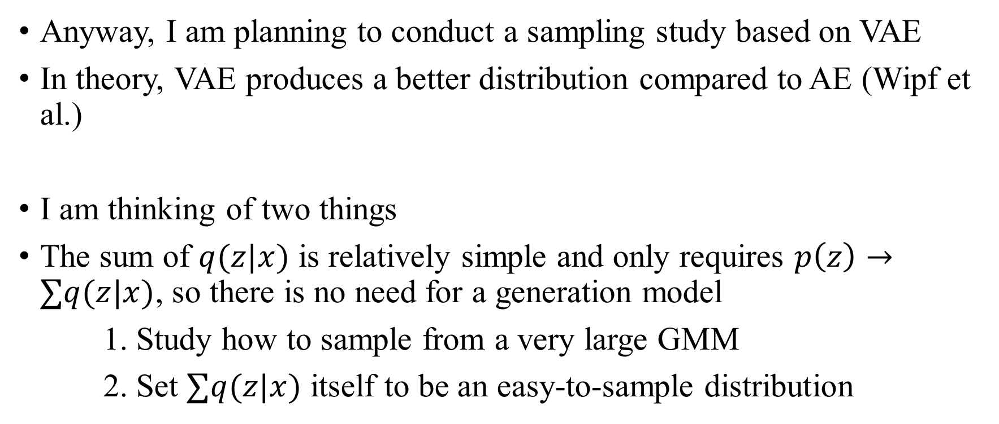
Possibility of regularized (V)AE
Anyway, I am planning to conduct a sampling study based on VAE
In theory, VAE produces a better distribution compared to AE (Wipf et al.)
I am thinking of two things
The sum of $q(z|x)$ is relatively simple and only requires $p\left(z\right)→∑q(z|x)$, so there is no need for a generation model
1. Study how to sample from a very large GMM
2. Set $∑q(z|x)$ itself to be an easy-to-sample distribution

Slide 8
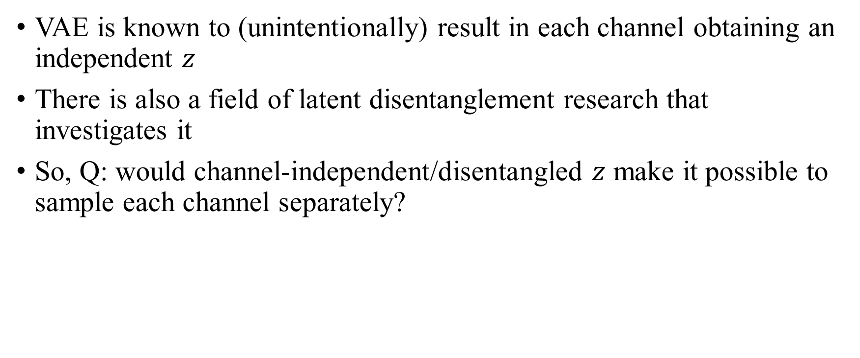
Discussion
VAE is known to (unintentionally) result in each channel obtaining an independent $z$
There is also a field of latent disentanglement research that investigates it
So, Q: would channel-independent/disentangled $z$ make it possible to sample each channel separately?

Slide 9
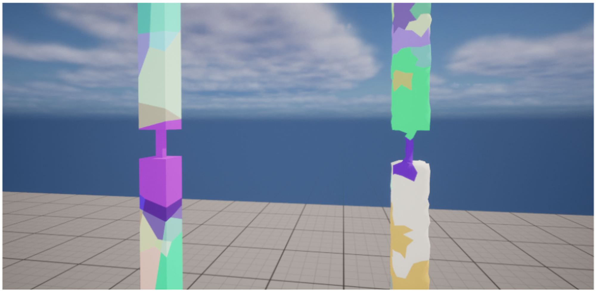
Fracture Deadline
Siggraph Asia 2024 Poster (11, Aug, 2024)
Eurographics 2024 Poster (Feb, 2024)
Probably 2025’s is probably next February?

Slide 10
Current State & Seminar
Hyunsoo is having difficulty using the old LIDVAE/ILLIDVAE code, so I am trying to rewrite it with pytorch to help him
Will the canceled lab seminar be held again soon?
The seminar topic will be studying Mamba from beginning to end

